Slide 1
ATAI
Chongqing University of Technology
Advanced Technique of Artificial Intelligence
Chongqing University of Technology
IMPROVING ABSTRACTIVE DIALOGUE
SUMMARIZATION WITH CONVERSATIONAL
STRUCTURE AND FACTUAL KNOWLEDGE（ICLR 2021）
Anonymous authors
Paper under double-blind review
Reported by Jia Wang
2021.03.23 • Chongqing

Slide 2
Outline
Introduction
Methodology
Experiments
Conclusion
Notes:
接下来我们将从以下几个方面来介绍这篇文章

Slide 3
Introduction
1) informal, verbose and repetitive, sprinkled with false-starts, backchanneling, reconfirmations,hesitations, and speaker interruptions.
2) previous methods are not suitable to generate summaries for dialogues.
3) we introduce the Knowledge Graph Enhanced Dual-Copy network.

Slide 4
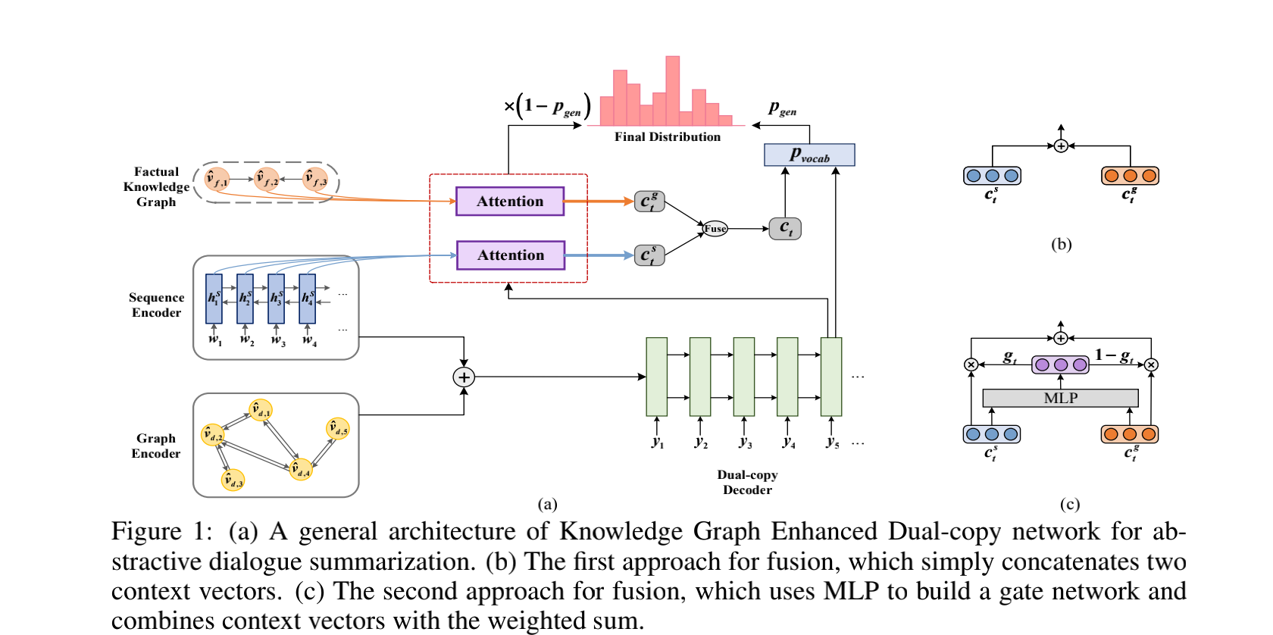
Methodology

Slide 5
sequence encoder

Slide 6
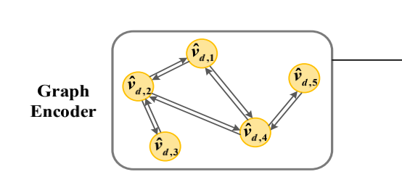
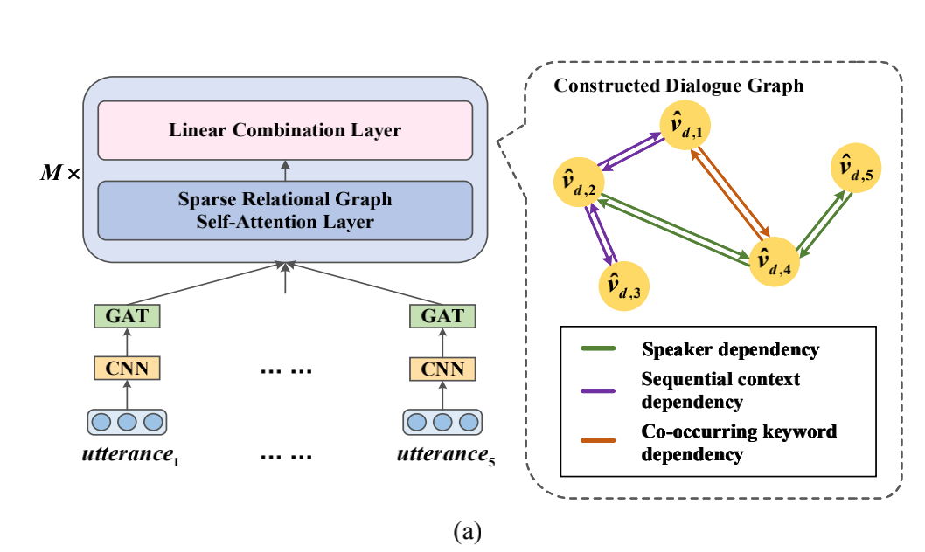
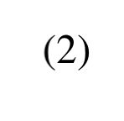
Graph encoder

Slide 7
Graph encoder

Slide 8
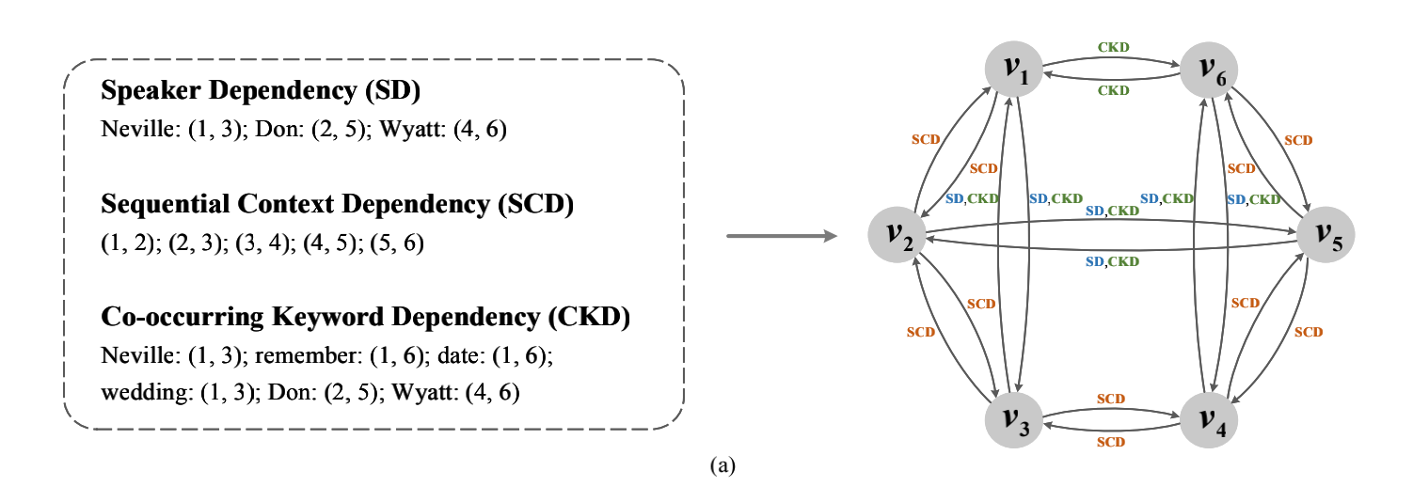
Graph encoder

Slide 9
Graph encoder

Slide 10
Graph encoder

Slide 11
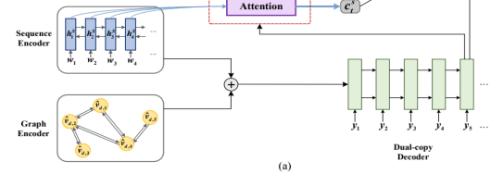
Methodology

Slide 12
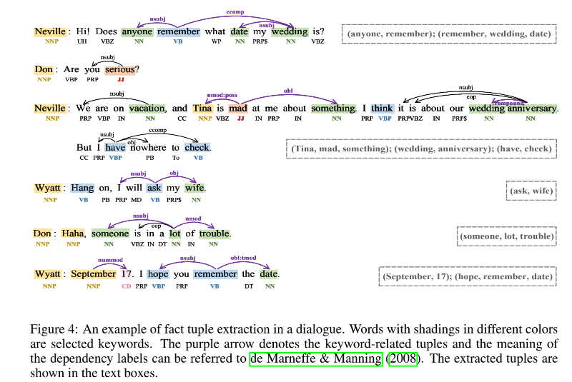
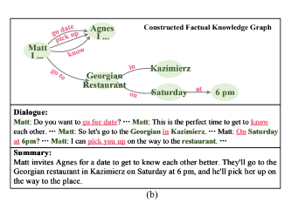
Facture Knowledge graph construction

Slide 13
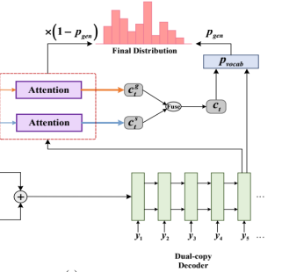
Dual-copy decoder
The context vector of the factual knowledge graph can be computed similarly.
Finally, the next token is generated based on the context vector Ct, the decoder state St, and the previous word Yt-1.

Slide 14
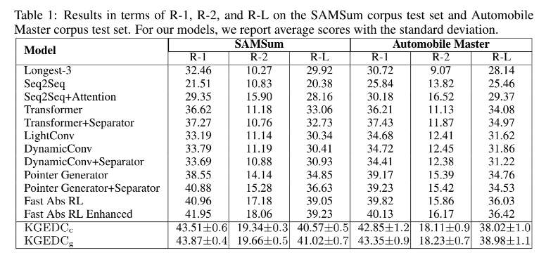
Experiments

Slide 15
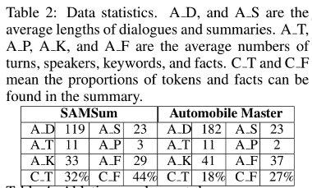
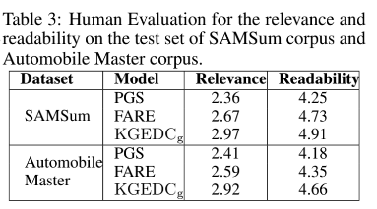
Experiments

Slide 16
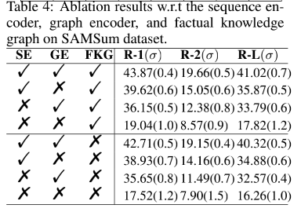
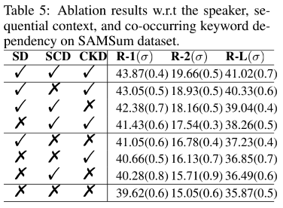
Experiments

Slide 17
Experiments

Slide 18
Conclusion
We propose a Knowledge Graph Enhanced Dual-Copy network for abstractive dialogue summarization. Our model explores the conversational structure via various semantic relations to construct a dialogue graph, which can capture long-distance cross-sentence dependencies. In tandem with copying from the source dialogue, our dual-copy mechanism utilizes factual knowledge graph to improve generated summaries. The human evaluation further confirms that the KGEDC produces more informative summaries and significantly reduces unfaithful errors.

Slide 19
Thanks!

